Slide 1
Data Storage – Part 1
CS 1301 Introduction to Computers

Slide 2
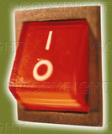
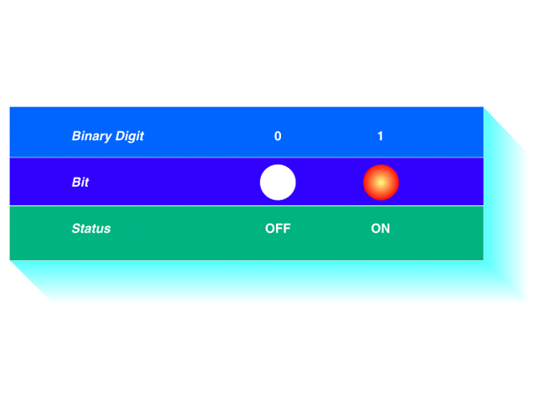
BIT – BInary digiT
Bit (Binary Digit) = Basic unit of information, representing one of two discrete states. The smallest unit of information within the computer.
The only thing a computer understands.
Abbreviation: b
Bit has one of two values:
0 (off) or 1 (on)
0 (False) or 1 (True)
OFF
ON

Slide 3

Bits
The boxes illustrate a position where magnetism may be set and sensed; pluses (red) indicate magnetism of positive polarity (1 bit), interpreted as “present” and minuses (blue) (0 bit).
0
1
1
0
1
0
0
0
1
0
1
1
0
1
0
1
Two patterns are known as the state of the bit.
For example, magnetic encoding of information on tapes, floppy disks, and hard disks are done with positive or negative polarity.

Slide 4


Bits
Bits are really only symbols.
Used to display the one of two different, discrete states.
Bits are used as:
Storing data
Numbers
Text characters
Images
Sound
Etc.
Processing data

Slide 5
Computers and Electricity
How do we describe the behavior of gates and circuits?
Boolean expressions
Uses Boolean algebra, a mathematical notation for expressing two-valued logic
Logic diagrams
A graphical representation of a circuit; each gate has its
own symbol
Truth tables
A table showing all possible input value and the associated
output values

Slide 6

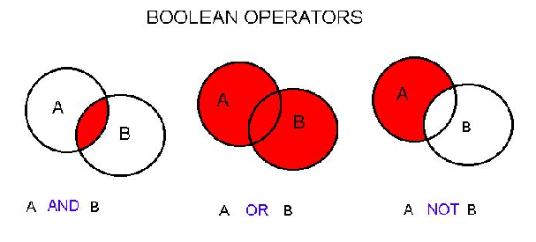
Boolean Operations
Integrated Circuits (microchips) are used to store and manipulate (process) bits.
This is done using Boolean operations (in honor of mathematician George Boole, 1815-1864).
Boolean Operation: An operation that manipulates one or more true/false values
Specific operations
AND
OR
XOR (exclusive or)
NOT
Using Truth Tables we can uses different sets of logic operations to store, add, subtract, and more complicated operations with bit.

Slide 7

Boolean Algebra and logical expressions (Addendum)
Boolean algebra (due to George Boole) - The mathematics of digital logic
Useful in dealing with binary system of numbers.
Used in the analysis and synthesis of logical expressions.
Logical expressions – Expressions constructed using logical-variables and operators.
Result is: True or False
Boolean algebra – In mathematics a variable uses one of the two possible values: 1 or 0
May also be represented as:
Truth or Falsehood of a statement
On or Off states of a switch
High (5V) or low (0V) of a voltage level

Slide 8
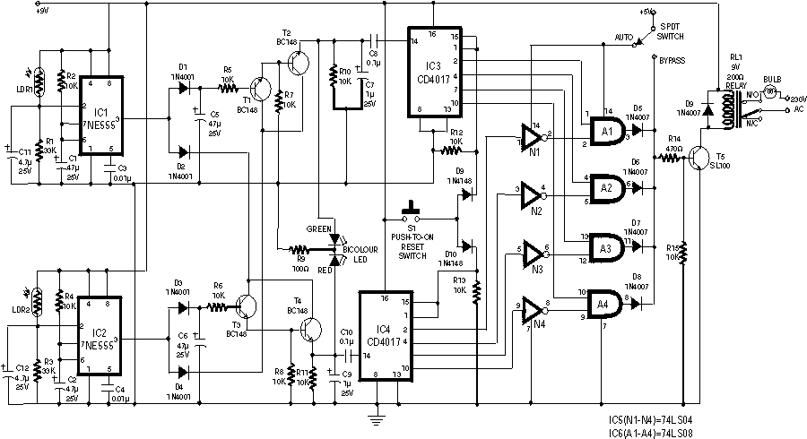
Used in electronics (Addendum)
Electrical circuits are designed to represent logical expressions
Known as logic circuits.
Used to make important logical decisions in household appliances, computers, communication devices, traffic signals and microprocessors.
Three basic logic operations as listed below:
OR operation
AND operation
NOT operation
A logic gate is an electronic circuit/device which makes the logical decisions based on these operations.

Slide 9
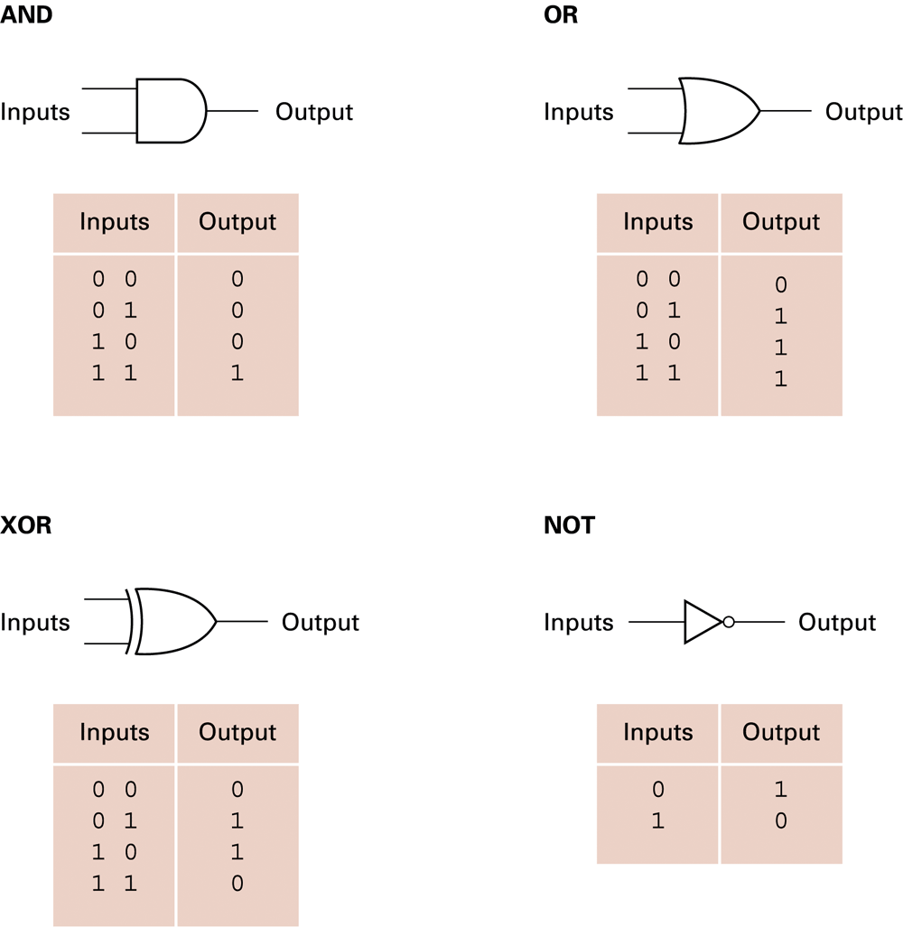
Logic gates (Addendum)
Logic gates have:
one or more inputs
only one output
The output is active only for certain input combinations.
Logic gates are the building blocks of any digital circuit.

Slide 10


Boolean Operations - AND
TRUE
TRUE
AND
= TRUE
Truth tables (simple ones)
AND operation
Both input values must be TRUE for output to be TRUE
Kermit is a frog AND Miss Piggy is an actress
Inputs to AND operation represent truth of falseness of the compound statement.

Slide 11
Boolean Operations
Gate:
A device that computes a Boolean operation
A device that produces the output of a Boolean operation when given the operation’s input values.
Gates can be:
Gears
Relays
Optic devices
Electronic circuits (microchips)

Slide 12


Boolean Operations – AND Gate
0
Truth Table
0
0
Inputs Output
0 0
0 1
1 0
1 1
0
0
0
0
1
0
1
1
0
0
0 = FALSE
1 = TRUE
AND operation
Both input values must be TRUE for output to be TRUE
1
1
1

Slide 13


Boolean Operations - OR
TRUE
OR
True
= TRUE
Truth tables (simple ones)
OR operation
Only one input values must be TRUE for output to be TRUE
In Rick likes to surf OR Rick likes to go dancing.
Taking both courses will also TRUE.

Slide 14

Boolean Operations – OR Gate
0
Truth Table
0
0
Inputs Output
0 0
0 1
1 0
1 1
0
0
1
1
1
1
1
1
1
0 = FALSE
1 = TRUE
OR operation
At least one input value must be TRUE for output to be TRUE
0
1
1
1

Slide 15


Boolean Operations - XOR
TRUE
XOR
False
= TRUE
Truth tables (simple ones)
XOR operation
One and ONLY one input value can be TRUE for output to be TRUE
At noon Rick is going to surf the Hook XOR surf Liquor Stores (this is a surf spot)
Both cannot be true, as I cannot surf both spots at the same time.

Slide 16

Boolean Operations – XOR Gate
0
Truth Table
0
0
Inputs Output
0 0
0 1
1 0
1 1
0
0
1
1
1
1
0
1
1
0 = FALSE
1 = TRUE
XOR operation
Only one input value is TRUE for output to be TRUE
0
1
0
1

Slide 17

Boolean Operations – NOT Gate
Truth Table
0
1
Inputs Output
0
1
1
1
0
0
0 = FALSE
1 = TRUE
NOT operation
Only one input
Opposite of input
NOT FALSE = TRUE
NOT TRUE = FALSE

Slide 18
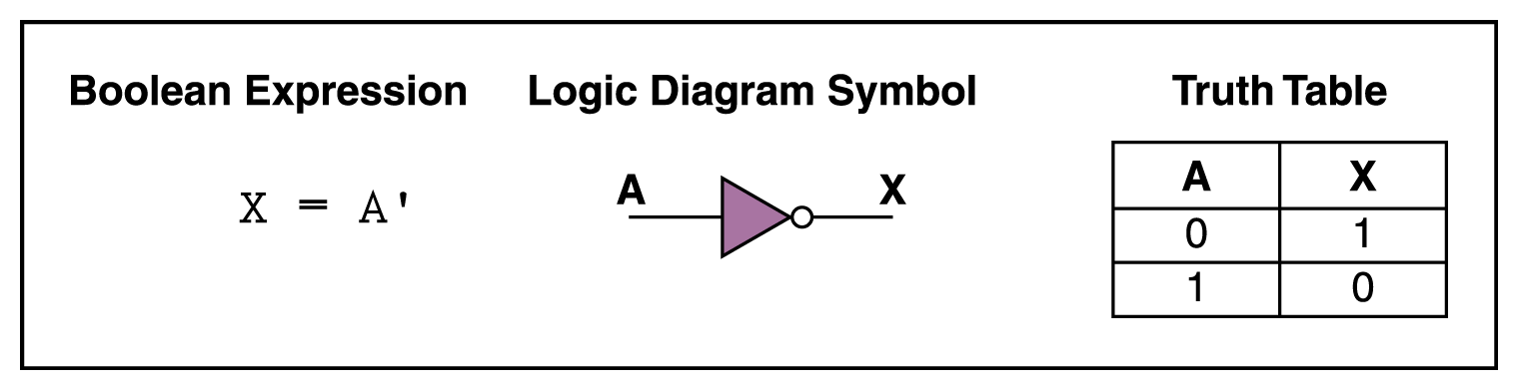
NOT Gate
A NOT gate accepts one input signal (0 or 1) and returns the opposite signal as output.
In Boolean expressions, the NOT operation is represented by the ‘ mark after the value being negated.
Figure 4.1 Various representations of a NOT gate
Inversion Bubble

Slide 19
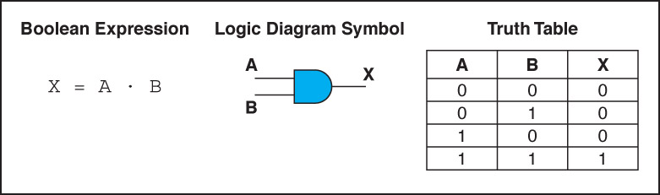
AND Gate
An AND gate accepts two input signals
If both are 1, the output is 1; otherwise,
the output is 0
In Boolean expressions, the AND operation is
represented using a single dot (.)
It is also written as AB.
Figure 4.2 Various representations of an AND gate

Slide 20
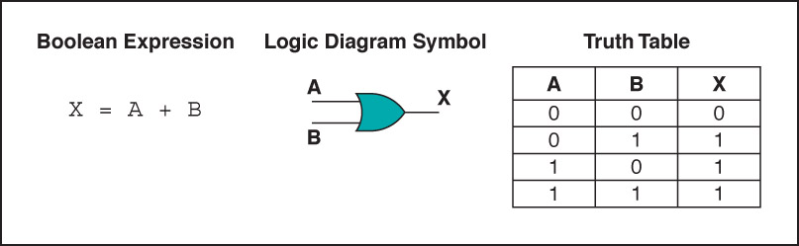
OR Gate
An OR gate accepts two input signals
If both are 0, the output is 0; otherwise,
the output is 1
Figure 4.3 Various representations of a OR gate

Slide 21
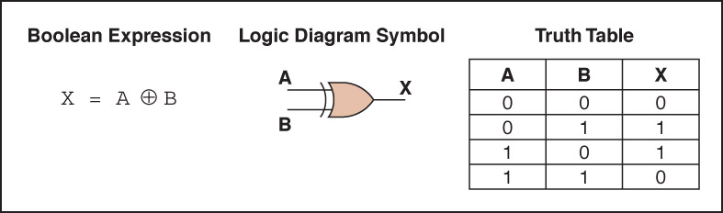
XOR Gate
An XOR gate (exclusive OR) accepts two input signals
If both are the same, the output is 0; otherwise,
the output is 1
Figure 4.4 Various representations of an XOR gate

Slide 22
XOR Gate
Note the difference between the XOR gate and the OR gate; they differ only in one input situation
When both input signals are 1, the OR gate produces a 1 and the XOR produces a 0
XOR is called the exclusive OR

Slide 23
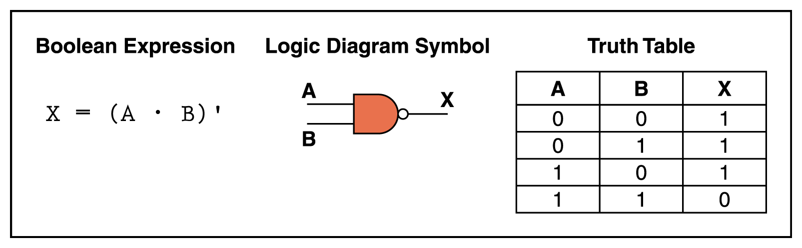
NAND Gate
The NAND gate accepts two input signals
If both are 1, the output is 0; otherwise,
the output is 1.
Figure 4.5 Various representations of a NAND gate
Difference is the Inverse bubble

Slide 24
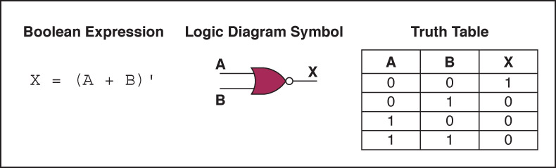
NOR Gate
The NOR gate accepts two input signals
If both are 0, the output is 1; otherwise, the output is 0.
The NAND and NOR gates are the opposites of the AND
and OR Gates.
That is, the output of a NAND gate is the
same as if you took output of an AND gate and put it
through an inverter (a NOT gate)
Figure 4.6 Various representations of a NOR gate

Slide 25
Review of Gate Processing
A NOT gate inverts its single input
An AND gate produces 1 if both input values are 1
An OR gate produces 0 if both input values are 0
An XOR gate produces 0 if input values are the same
A NAND gate produces 0 if both inputs are 1
A NOR gate produces a 1 if both inputs are 0

Slide 26
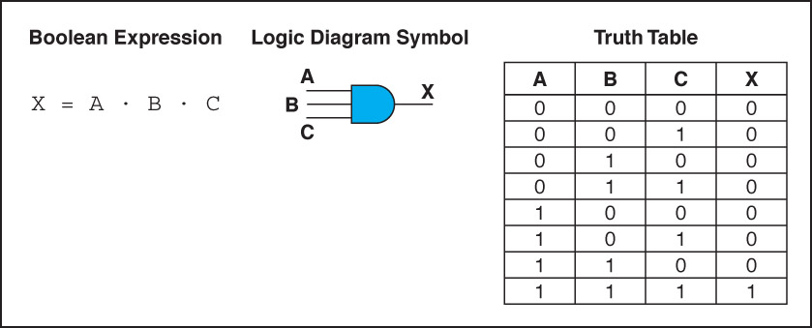
Gates with More Inputs
Gates can be designed to accept three or more input values
A three-input AND gate, for example, produces an output of 1 only if all input values are 1
Figure 4.7 Various representations of a three-input AND gate

Slide 27
Flip-flops
Flip-flop: A circuit built from gates that can store one bit.
One input line is used to set its stored value to 1
One input line is used to set its stored value to 0
While both input lines are 0, the most recently stored value is preserved

Slide 28
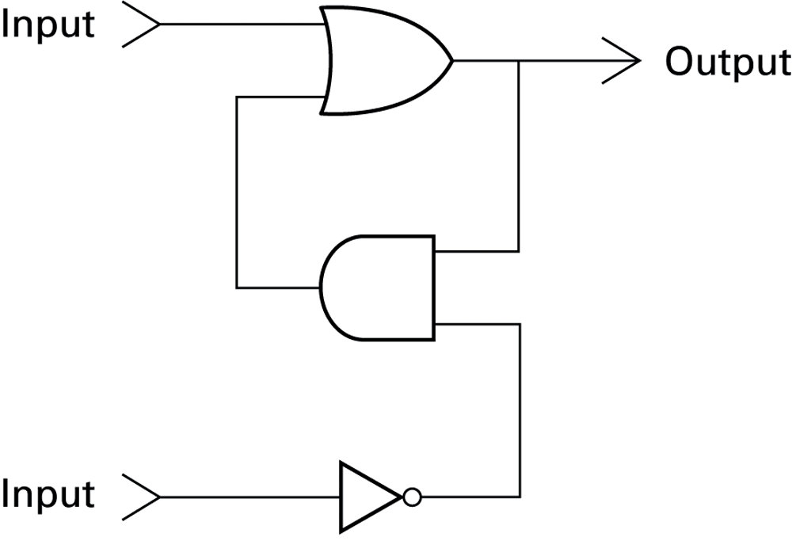
Figure 1.3 A simple flip-flop circuit

Slide 29
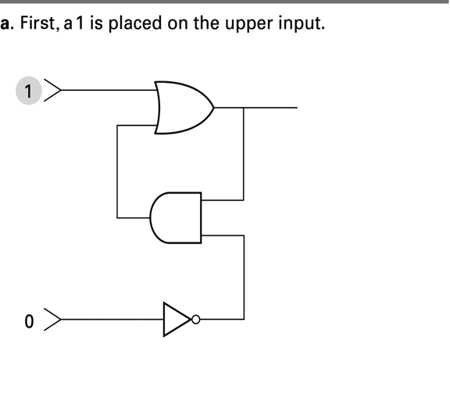
Figure 1.4 Setting the output of a flip-flop to 1

Slide 30
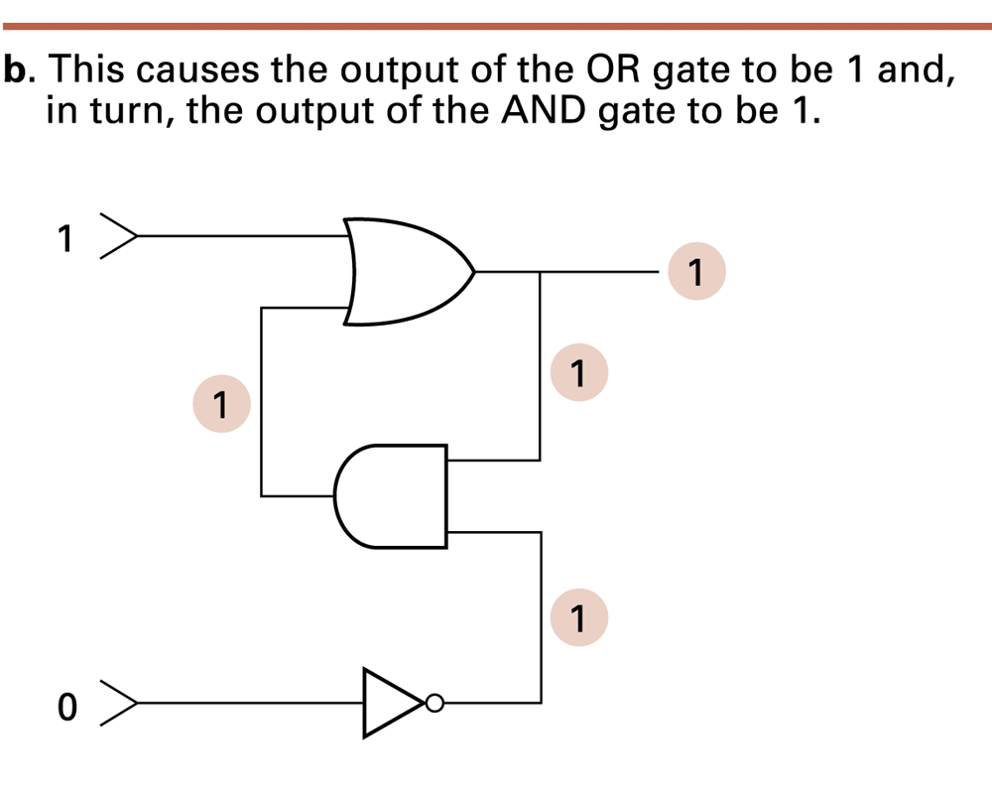
Figure 1.4 Setting the output of a flip-flop to 1 (continued)

Slide 31
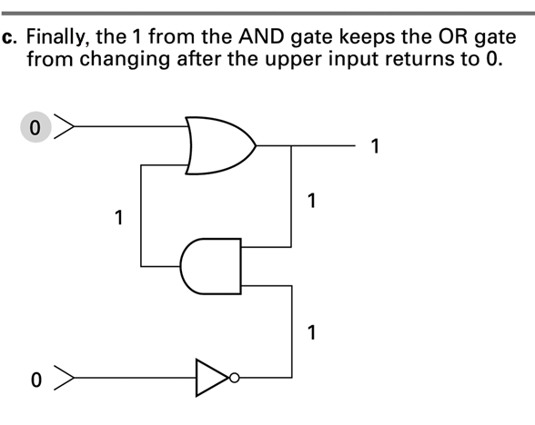
Figure 1.4 Setting the output of a flip-flop to 1 (continued)

Slide 32
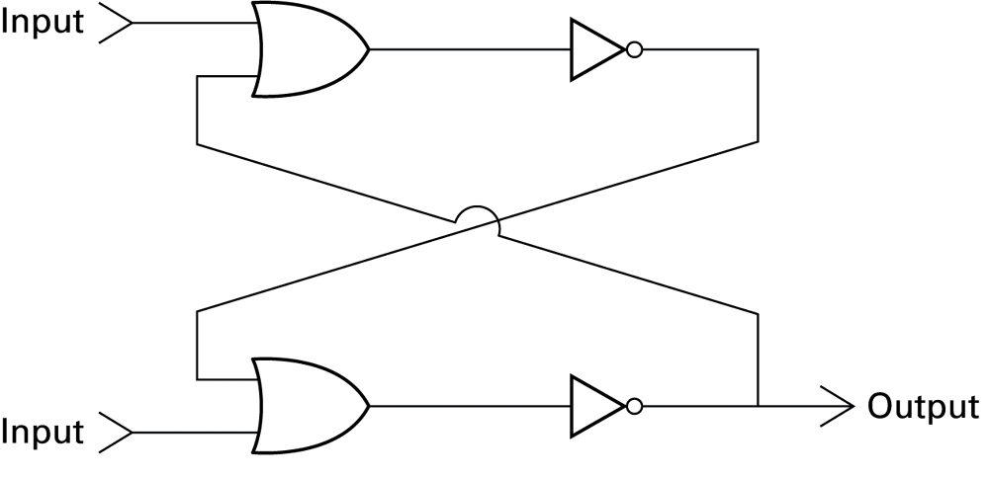
Figure 1.5 Another way of constructing a flip-flop

Slide 33
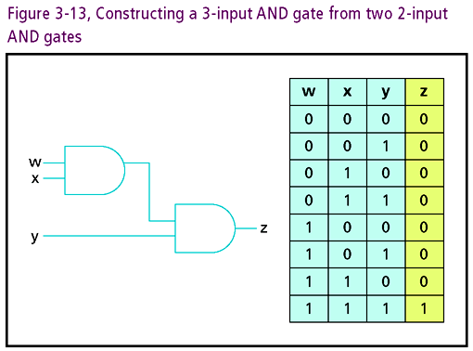
GATES

Slide 34
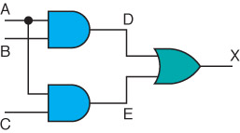
Combinational Circuits
Gates are combined into circuits by using the output of one gate as the input for another
The output of the two AND gates is used as the input to the OR gate. The input A is used as input to both AND gates. The dot indicates that two lines are connected. If there is no dot consider it as “jumping over” the other without affecting each other.

Slide 35
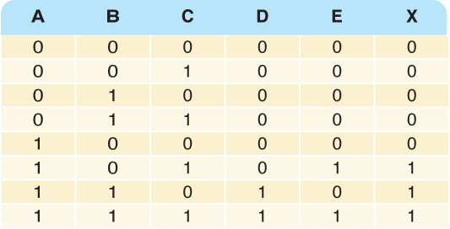
Combinational Circuits
Working backwards for X to be 1, either D must be 1 or E must be 1. Both E and D may be 1, but tat isn’t necessary.
Three inputs require eight rows to describe all possible input combinations
This same circuit using a Boolean expression is (AB + AC)

Slide 36

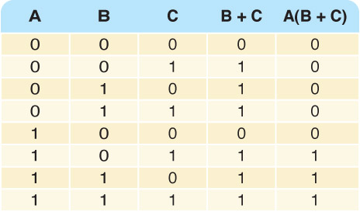
Combinational Circuits
Consider the following Boolean expression A(B + C)
The OR operation is applied to to input values B and C
The result of the operation is used as input, along with A, to an AND operation, producing the final result
Does this truth table look familiar?
Compare it with previous table

Slide 37
Combinational Circuits
Circuit equivalence
Two circuits that produce the same output for identical input
Boolean algebra allows us to apply provable mathematical principles to help design circuits
A(B + C) = AB + BC (distributive law) so circuits must be equivalent

Slide 38
Circuits
Combinational circuit
The input values explicitly determine the output
Sequential circuit
The output is a function of the input values and the existing state of the circuit
We describe the circuit operations using
Boolean expressions
Logic diagrams
Truth tables

Slide 39
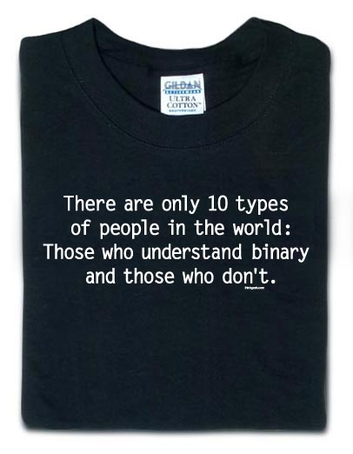
Binary Math

